Slide 1

Data Analytics Using Python Dr. Ziping Liu
Chapter 7 Data Modeling

Slide 2
Chapter 7 Data Modeling
https://he.kendallhunt.com/product/data-analytics-using-python

Slide 3
Introduction to Modeling
develop mathematical or statistical models to represent the data distribution and make future predictions
helps comprehend past events (descriptive analytics), understand why they occurred (diagnostic analytics), and predict future occurrences (predictive analytics)
statistical models or machine learning models
Python-based libraries such as statsmodels, scikit-learn, TensorFlow, and PyTorch
The statsmodels package: statistical modeling, providing a broad range of traditional statistical tools
scikit-learn, TensorFlow, and PyTorch: machine learning modeling, offering diverse tools and algorithms for various machine learning tasks

Slide 4
Linear Regression
represent a continuous and linear relationship between a dependent variable (Y) and one or more independent variables (X)
find the linear equation that best fits the data points of the independent and dependent variables with the linear equation minimizing the overall prediction error

Slide 5
Linear Regression
use statsmodel to perform one-way ANOVA
Performance measure: F-statistic and p-value
import statsmodels.api as sm
from statsmodels.formula.api import ols
# Perform one-way ANOVA
model_sm_anova = ols('Y ~ X', data=df).fit()
anova_results = sm.stats.anova_lm(model_sm_anova, typ=1)
print(anova_results)

Slide 6
Linear Regression
Use statsmodel's linear regression
Performance measure:
R-squared, adjusted R-squared values - the dependent variable
p-values for both the F-statistic and the coefficients - the model and the predictors statistically significant or not
p-values for the residual tests (Omnibus and Jarque-Bera) - normally distributed or not
Durbin-Watson statistic autocorrelation in the residuals
from sklearn.metrics import mean_squared_error, r2_score
# Create the OLS model and fit it
model_sm_ols = sm.OLS(payments,claims_ols).fit()
Y_pred_sm = model_sm_ols.predict(claims_ols)
# Print the model summary
print(model_sm_ols.summary())
# Performance metrics
r2_sm = model_sm_ols.rsquared
mse_sm = mean_squared_error(df['Y'], Y_pred_sm)
print(f"\nstatsmodels performance - R-squared: {r2_sm:.4f}, MSE: {mse_sm:.4f}")

Slide 7
Linear Regression
linear regression using scikit-learn library
Performance: R-squared and Mean Square Errors
from sklearn.linear_model import LinearRegression
from sklearn.metrics import mean_squared_error, r2_score
model_sk = LinearRegression()
model_sk.fit(X, Y)
# Predicted values
df['Predicted_Y_SK'] = model_sk.predict(X)
Y_pred_sk = model_sk.predict(X)
# Performance metrics
r2_sk = r2_score(Y, df['Predicted_Y_SK'])
mse_sk = mean_squared_error(Y, df['Predicted_Y_SK'])
print(f"scikit-learn performance - R-squared: {r2_sk:.4f}, MSE: {mse_sk:.4f}")

Slide 8
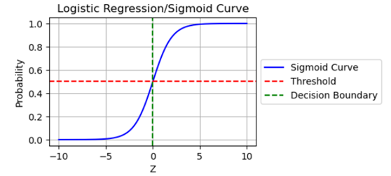
Logistic Regression
a classification model that predicts the probability that the dependent variable (Y) belongs to a binary outcome (0 or 1) based on one or more independent variables (X)
achieved by using the logistic function (or sigmoid function) to constrain the output between 0 and 1

Slide 9
Logistic Regression
using statsmodels
achieved by using the logistic function (or sigmoid function) to constrain the output between 0 and 1
Performance measure:
R-squared value
p-values for each independent variable
entropy
LLR p-value
import statsmodels.api as sm
# Fit the logistic regression model with intercept
logit_model = sm.Logit(y, sm.add_constant(X)) # Adding constant for intercept
result = logit_model.fit()
print(result.summary2())

Slide 10
Logistic Regression
scikit-learn library
Performance measure:
accuracy_score
classification_report
from sklearn.model_selection import train_test_split
from sklearn.linear_model import LogisticRegression
from sklearn.metrics import accuracy_score
# Initialize the logistic regression model
log_reg_sk = LogisticRegression(random_state=0)
# Train the model
log_reg_sk.fit(X_train, y_train)
# Make predictions
y_pred = log_reg_sk.predict(X_test)
# Evaluate the model
accuracy = accuracy_score(y_test, y_pred)
print(f"Accuracy: {accuracy}")
from sklearn.metrics import confusion_matrix, classification_report
# Confusion Matrix
conf_matrix = confusion_matrix(y_test, y_pred)
print("\nConfusion Matrix:")
print(conf_matrix)
# Classification Report (Precision, Recall, F1-Score)
class_report = classification_report(y_test, y_pred)
print("\nClassification Report:")
print(class_report)

Slide 11
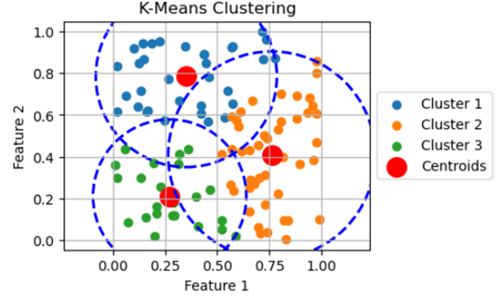
K-means Clustering
centers solely on the independent variables (X) without predicting a dependent variable
used to group data points into K distinct clusters based on similarities in their features
the number of clusters (K) must be predetermined

Slide 12
K-means Clustering
Two techniques help determine the optimal number of clusters: the elbow method and silhouette analysis.
In the elbow method, a plot illustrates the change in Within-Cluster Sum of Squared Errors (WCSS) for different k values. The optimal k value is typically at the "elbow" point in the curve where the WCSS starts to decrease more slowly.
Silhouette analysis involves calculating a silhouette coefficient for each data point, ranging from -1 to 1. The average silhouette score across all points measures overall cluster separation, with higher scores indicating better separation.

